Slide 1
COVID-19 in numbers
Canada’s Fight against Coronavirus

Slide 2
Hypothesis
With what we know, COVID-19 will have a stronger effect on major cities.
There are evidence that shows elderly are more likely to be severely effected by the virus than their younger counterparts and we like to see if that holds true with our data.
We know the strategies(time of lockdown, severity of lockdown) across selected province and want to discover how effective each strategies were in combatting the pandemic.

Slide 3

Measures taken across the country
This Photo by Unknown Author is licensed under CC BY-ND

Slide 4
Timeline
Alberta
First Case: March 5
Self-isolation/Social Distancing Measures: March 25
Halt Nursing Homes Visits: April 7
Ontario
First Case: January 22
State of Emergency: March 17
Banning visits to LTC Facilities: March 14
Halt transfer to Nursing Homes: April 17
British Colombia
First Case: January 28
State of Emergency: March 18
Banning Visits to LTC Facilities: March 21

Slide 5
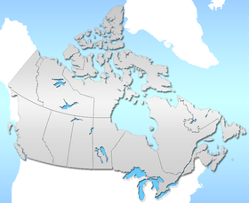
Data Sources
This Photo by Unknown Author is licensed under CC BY-SA

Slide 6

Methodology
Data Collection
Requests
Splinter
Data Cleaning
Pandas
Data Loading
SQL
API Creation

Slide 7

Data Extraction
QUERYING
API/URL
D3.JSON
This Photo by Unknown Author is licensed under CC BY

Slide 8

visualization

